Slide 1
Database & Storage Security
Professor Dr. Mohammad Abu Yousuf
yousuf@juniv.edu

Slide 2
Database issues in Trust Management & Trust Negotiation
Notes:
Play the slide show for this presentation to listen to the audio commentary by Peter Walsh and view slide timings. Or, click the sound icon on a slide for controls that you can use to hear the audio at your own pace.
A little organization will go a long way to enhancing your PowerPoint presentation.
Your title slide should be catching and relevant to your audience – offer something in the title that your audience wants.
Keep some basic principles in mind:
Your slides should complement what you have to say, not say it for you.
Keep slides direct and to the point - less is more!
Choose a background color or design that enhances and complements your presentation rather than competes with it.
Don’t get too fancy - a simple font, elegant color scheme and clear message is more important than lots of information (clutter!) on the slide.
Keep it simple! The purpose of the PowerPoint slide is to keep the mind of your audience focused – fewer words are better.
Note: You understand that Microsoft does not endorse or control the content provided in the following presentation.

Slide 3
Trust Management – Basic
Trust Management, introduced by Blaze et al. [BFL96], is a unified approach to specifying and interpreting security policies, credentials, and relationships that allows direct authorization of security-critical actions.
In particular, a trust management system combines the notion of specifying security policy with the mechanism for specifying security credentials.
Credentials describe specific delegations of trust among public keys; unlike traditional certificates, which bind keys to names, trust-management credentials bind keys directly to authorizations to perform specific tasks.

Slide 4
Trust Management – Basic
A traditional “system-security approach” to the processing of a signed request for action treats the task as a combination of authentication and access control.
The receiving system first determines who signed the request and then queries an internal database to decide whether the signer should be granted access to the resources needed to perform the requested action.
Question- “who signed this request?”
The trust management approach, initiated by Blaze et al. [BFL96], frames the question as follows: “Does the set C of credentials prove that the request r complies with the local security policy P?”
Notes:
Consider sub-headings that provide an emotional or action-oriented aspect to your presentation – these can be very motivating to an audience.

Slide 5
Trust Management – Physical World
Certified credentials form the BASE of trust.
Citizens identify themselves
at the voting booth with national identity cards,
motorists demonstrate their right to drive cars with driver licenses,
customers pay for their groceries with credit cards,
airline passengers board planes with their passports and boarding passes, and
sport enthusiasts make their way into the gym using their membership cards.
Often such credentials are used in contexts beyond what was originally intended:
for example, identity cards are also used to prove eligibility for certain social benefits, or to demonstrate to be of legal age when entering a bar.
Notes:
Consider sub-headings that provide an emotional or action-oriented aspect to your presentation – these can be very motivating to an audience.

Slide 6
Trust Management – Physical World
Each of these credentials contains attributes that describe
the owner of the credential (e.g., name and date of birth),
the rights granted to the owner (e.g., vehicle class, flight and seat number),
or the credential itself (e.g., expiration date).
The information in the credentials is trusted because it is certified by an issuer (e.g., the government, a bank) who on its turn is trusted.
Hence the credential works well in trust management.
Notes:
Consider sub-headings that provide an emotional or action-oriented aspect to your presentation – these can be very motivating to an audience.

Slide 7
Trust Management – Physical World
What these credentials (certificates) carry?
Identity of the subject.
Only authorization is required to have access
Train/Bus Ticket
University ID card to get access in the main gate of the campus.
Cinema ticket, cricket match ticket
Both Identity & Authorization
Student entry in the exam hall.
To obtain Boarding pass in the plane.
Identity of the issuer.
Notes:
Consider sub-headings that provide an emotional or action-oriented aspect to your presentation – these can be very motivating to an audience.

Slide 8
Trust Management – Physical World
How Trust management occurs in this world?
Half ticket fare for students of train and bus
National ID + Student ID
Free ticket for Bangladeshi students to access to zoo
National ID + Student ID
Free access to all nationally arranged games and sports for Bangladeshi athletes
National ID + Athletes ID from games and sports authority.
Free access to all public libraries for the Bangladesh students.
National ID + Student ID
Notes:
Consider sub-headings that provide an emotional or action-oriented aspect to your presentation – these can be very motivating to an audience.

Slide 9
Trust Management – Physical World
Analysis of the traditional TM activities:
Resource Access Policy:
It governs the access rights to the resources.
It lies in the hands of resource owner.
They decide which certificate (Passport, National ID, Student ID etc.) they will use for which resources.
Notes:
Consider sub-headings that provide an emotional or action-oriented aspect to your presentation – these can be very motivating to an audience.

Slide 10
Trust Management – Physical World
Analysis of the traditional TM activities:
Security credential:
It certifies (binds) the identity(name, address, Serial no etc.) of the resource requester.
The certificates need to be verified by the resource owner.
Only physical verification (signature, seal, logo etc.) on the spot.
Chance of fabricated certificate.
Notes:
Consider sub-headings that provide an emotional or action-oriented aspect to your presentation – these can be very motivating to an audience.

Slide 11
Trust Management – Physical World
Analysis of the traditional TM activities:
Certificate Authority:
Some third parties (Passport Office, Election Commission, University authority etc.) produces and distributes the security credentials.
They certifies the identity only of the user of the certificates.
They do not bear the responsibility of a certificate holder’s fraudulent transactions.
Notes:
Consider sub-headings that provide an emotional or action-oriented aspect to your presentation – these can be very motivating to an audience.

Slide 12
What is Trust Management System?
A mechanism where authorization decision is taken on the fly in the Internet with no pre-established relationship.
Uses cryptographic credentials (PGP, X.509) to convey information relevant to authorization.
Authorization decision: whether the information contained in a given set of credentials are sufficient to access the requested resource as per the current policy governing that resource.

Slide 13
What is Trust management?
In TM system, security policy is made by local administrators to specify access control rules on local resources.
Credentials in TM system usually do not typically bind public keys to identities.
It binds other information on which authorization decisions are based.

Slide 14
What is Trust management?
Credentials may also grant the right to further delegate the capability.
Chains of such credentials can be used to document a sequence of delegations of privileges from the resource owner to the requester.

Slide 15
Steps of credential based TM Application
Obtain certificates, verify signatures on certificates and on application request, determine public key of original signer(s).
Verify that certificates are unrevoked.
Attempt to find “trust path” from trusted certifier to certificate of public key in question.
Extract names from certificates.
Lookup names in database that maps names to the actions that they are trusted to perform.
Determine whether requested action is legal, based on the names extracted from certificates and whether the certification authorities are permitted to authorized such actions according to local policy.
Proceed if everything appears valid.

Slide 16
Steps of TM System based Application
Obtain certificates, verify signatures on certificates and on application request, determine public key of original signer(s).
Verify that certificates are unrevoked.
Submit request, certificates, and description of local policy to local “trust management engine”.
Proceed if approved.

Slide 17
Three Components of Trust Management
Security policies which are local trust assertions that the local system trust unconditionally.
Security Credentials which are signed trust assertions made by other parties.
Trust Relationship – issuance of certificates by any parties initiates the trust relationships.

Slide 18
Purpose of Trust Management
A mechanism that allows one to decide which requesters are qualified to gain access to the resource.
on the other hand, which server is trusted to provide the requested service, on the basis of certified statements provided by the interacting parties is needed.
Notes:
Consider sub-headings that provide an emotional or action-oriented aspect to your presentation – these can be very motivating to an audience.

Slide 19
Trust management in digital world
Managed through Access Control
Authorization Policy
Various privileges/roles
Assigning userID with these privileges/roles.
Identification and authentication
Log in with Username & Password and its verification
Authorization
Matching userID with the authorization policy.

Slide 20
Trust management in digital world
Within a single organization, pre-established trust relationships are used to assign authorizations.
Among the organizations of the trading partners, pre-established trust relationship increases administrative burden of managing a large number of users of all organizations.
It becomes very difficult to manage the trust between two users when there is no pre-established trust relationship.

Slide 21
Trust management in digital world
The complexity culminates when there is a need for anonymity of users (electronic voting).
A new technique is required that enables on-line parties to establish trust on the fly.

Slide 22
Trust management in digital world
Trust Management with TM System
Most are based on public key “certificates” in which a trusted 3rd signs a specially formed message certifying the identity associated with a public key.
How the certified identity is acted upon is left to the application.
Two best known certificate systems are
PGP
X.509

Slide 23
Trust Management using PGP certificates
How does PGP works?
Pretty Good Privacy uses a variation of the public key system. In this system, each user has an encryption key that is publicly known and a private key that is known only to that user.
You encrypt a message you send to someone else using their public key. When they receive it, they decrypt it using their private key.
.

Slide 24
Trust Management using PGP certificates
How does PGP works?
Since encrypting an entire message can be time-consuming, PGP uses a faster encryption algorithm to encrypt the message and then uses the public key to encrypt the shorter key that was used to encrypt the entire message.
Both the encrypted message and the short key are sent to the receiver who first uses the receiver's private key to decrypt the short key and then uses that key to decrypt the message.

Slide 25
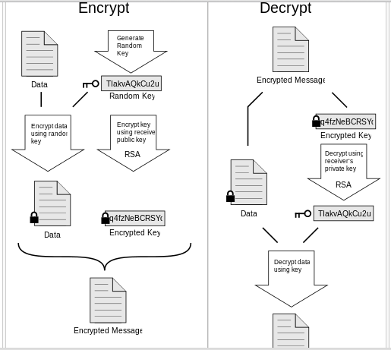
Trust Management using PGP certificates
How does PGP works?

Slide 26
Trust Management using PGP certificates
The combination of the two encryption methods combines the convenience of public key encryption with the speed of conventional encryption.
Conventional encryption is about 1, 000 times faster than public key encryption. Public key encryption in turn provides a solution to key distribution and data transmission issues.
Used together, performance and key distribution are improved without any sacrifice in security.

Slide 27
Trust Management using PGP certificates
Public Key Ring
ID, PK, Time Stamp
Trust score (unknown, untrusted, marginally trusted, completely trusted etc.)
Secret Key Ring
SK
PGP
Certificate verification
A
Trusted introducer of XYZ company
XYZ Company
B
File1
File2
File3
Application
C
Limitations
TM decision is done by Application.
Communication between PGP and Application is proprietary
Limitation of policy versatility
a
-Wants to have access to File1
-Has a certificate from C

Slide 28
Trust Management using PGP certificates
Trust Management using PGP certificates
A user generates a key pair (PublicKey, SecretKey) that is associated with his unique ID (Name, Email Address)
Keys are stored key records with timestamp:
Public Key Ring: All public keys
Secret Key Ring: Own secret key.
User A has a good copy of user B’s public key record.
User A can sign this copy (Key Certificate) and pass it to C. Thus A acts as an introducer.

Slide 29
Trust Management using PGP certificates
Each user must tell the PGP system which individuals he or she trusts as introducers and must certify the introducers’ public key records with his own secret key.
A user may specify degree of trust:
Unknown, untrusted, marginally trusted, completely trusted etc.
Each user stores his trust information on his key rings and tunes PGP so that it assigns a validity score to each certificate on a key ring.
It uses the score to authorize the transaction.

Slide 30
Trust Management using PGP certificates
Security policy: Verification of ID of sender.
Key rings and degrees of trust allow each user to design his own security policy of very limited form.
PGP is for secure email communication.
No certificate authority.
No centralized trust servers for certificate distribution.

Slide 31
PGP Certificate
The user chooses how to use the certificate.
User C might be confident about A’s trustworthiness and accept B’s certificate, which A has signed.
A pessimistic user might only accept certificates certified by fully trusted entities, whereas an optimistic user might trust marginally trusted signers.

Slide 32
Trust Management using X.509 certificates
In X.509, the trusted third party is a certificate authority (CA), which is usually a trustworthy entity for issuing certificates (Verisign, for example).
Another CA might also certify a particular CA.
When a user generates a public/private key pair, it registers its public key with a CA and has the CA certify it.

Slide 33
Trust Management using X.509 certificates
If the same CA certifies two users and they want to communicate securely, they need only exchange their certificates.
If different CAs certify two users, they must resort to higher-level CAs, which certify their CAs until they reach a common CA.
So, X.509 uses a hierarchical structure, which constructs a tree of trust.

Slide 34
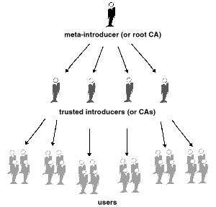
X.509 Certificate

Slide 35
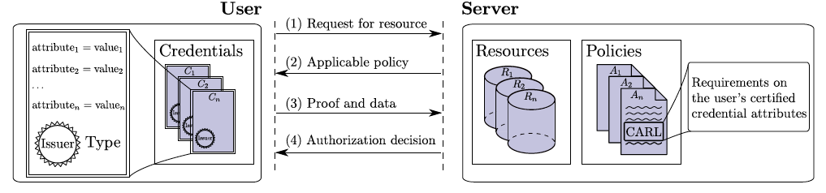
Credential Based Access Control
Raw material: Credentials & Policy

Slide 36
Problems of TM based on PGP & X.509
Application specific.
Identity based certification that is used in trust management.
Security policy can not be made versatile.
Trust management is done by the Application itself.
No further modification.

Slide 37
Seminal works on this issue:
Bina et al. proposed using characteristics other than identity, attested to by known authorities in digital certificates, as a basis for authorization on the Internet
Blaze et al. introduced a complementary approach to authorization based on delegation of privileges.
Rivest et al. introduced a scheme that provides a way to introduce names and bind them to public keys controlled by individuals and groups, which greatly facilitates identifying authorized principals electronically.

Slide 38
Challenges in TM Process
Credentials are issued in a decentralized manner and somehow the relevant credentials need to be collected or otherwise made available to the authorization evaluation process.
Some credentials carry sensitive, confidential information and may need to be subject to access control themselves.

Slide 39
Challenges in TM Process
An access control policy may give clues about the nature of the resources it protects.
If a patient’s prescription can be viewed only by their pharmacist or by their parent, then one can guess that the prescription is for a child.
To preserve the privacy of the resources that they protect, policies themselves may need protection.
In other word, access to the contents of a policy may need to be governed by another access control policy.

Slide 40
Parties in Trust Management
Certificate Authority
Cryptographic credentials (X.509, PGP)
Digital Certificate & Digital Signature
Resource requester
Cryptographic credentials (X.509, PGP)
Digital Certificate & Digital Signature
Resource Provider
Cryptographic credentials (X.509, PGP)
Digital Certificate & Digital Signature
Resource
Security Policy that governs the access to the resource

Slide 41
Trust Negotiation
An automated approach to establish bilateral trust between two parties at run time.
Gradually disclosure of information by both parties to establish the trust being guided by information disclosure policy of both parties.
A process of credential exchange in which both parties seek to enable a positive authorization decision for the main resource requester, while also supporting the additional authorization decisions that may be necessary to achieve this.
Notes:
Consider sub-headings that provide an emotional or action-oriented aspect to your presentation – these can be very motivating to an audience.

Slide 42
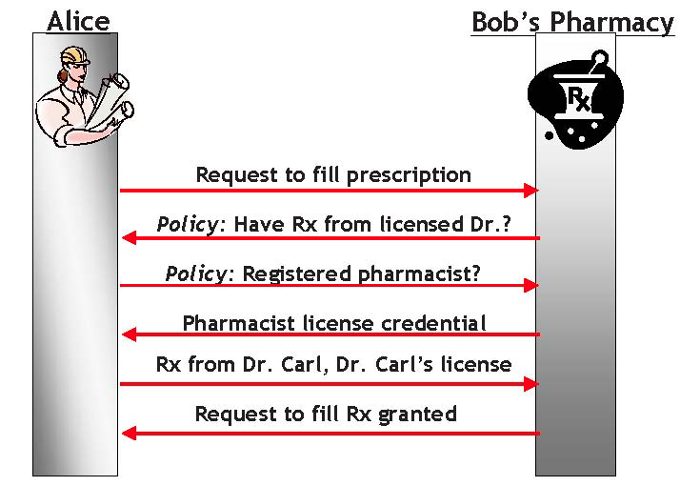
Trust Negotiation
Alice Bob’s Pharmacy

Slide 43
Language for TM System
Datalog
a language used extensively in deductive database systems.
Authorization decisions are obtained by evaluating a query involving the client and the requested resource.
Evaluation in general requires collecting data and rules from distributed repositories.
Notes:
Consider sub-headings that provide an emotional or action-oriented aspect to your presentation – these can be very motivating to an audience.

Slide 44
Trust Management Approaches
PolicyMaker
KeyNote

Slide 45
PolicyMaker – First TM System
General principles of PolicyMaker TM System
Unified mechanism: Policies, credentials and trust relationships are expressed as programs (or part of programs) in a safe programming language.
Flexibility: can support the complex trust relationship that can occur in the very large network applications.
Locality of control: Each party can decide in each circumstance whether to accept the credentials presented by the second party.
Separation of mechanism from policy: The mechanism for verifying credentials does not depend on the credentials themselves.

Slide 46
PolicyMaker – First TM System
CA
Client request
Certificate with action privilege
+ request
Credential verification
Application that handles access request
A request (action), a policy & a set of credentials
PolicyMaker TM System
Yes/no
Acts like a DB query engine
Tasks:
Local policy update,
Deciding whether additional credential is required
Credential verification, revocation and
Sending and receiving trust message.
Tasks:
Input verification and
sending yes/no

Slide 47
PolicyMaker – First TM System
An Application plus Trust Management Engine(TME)
The PolicyMaker service appears to Applications very much like a database query engine.
TME accepts as input a set of local policy statement, a collection of credentials and a string describing a proposed trusted action.
It evaluates proposed actions by interpreting the policy statements and credentials.
It returns either a simple yes/no answer or additional restrictions that would make the proposed action acceptable.

Slide 48
PolicyMaker – First TM System
The certificates and certificate revocation are obtained by Application. Key verification is also done by Apps.
Security policies and credentials are defined in terms of predicates (filters) that are associated with public keys.
Filters accept or reject action descriptions based on what the holders of the corresponding secret keys are trusted to do.
Security policies and credentials consist of a binding between a filter and one or more public keys.
Filters can be written in a variety of interpreted languages.

Slide 49
PolicyMaker – First TM System
Assertions (Security Policies & Credentials) have the form
“<Source> ASSERTS <AuthorityStruct> WHERE <Filter>.””
<Source> field identifies the authority that makes this assertions (CA).
<AuthorityStruct> field contains the subjects to whom this assertion applies (Requester).
<Filter> field has an Application Specific string <action-string> that must be satisfied for the assertion to hold.
The whole assertion states that the <source> trusts the subject<AuthorityStruct> to be associated with <action-string>.

Slide 50
PolicyMaker – First TM System
Example (All employees of all banks):
A loan request is submitted to an electronic banking system.
The request may contain EmployeeID, Bank Code, Employee name, Designation and amount requested along with other information.
Trust Relationship:
Each bank creates a digital certificate for each of its employee.
The certificate contains EmployeeID, Bank Code & Employee name, Designation.
Policy that can handle such request:
Two approvals by two employees are required for loans less than $5000
Three approvals are required for loans >$5000 and <$10000
Loans >$10000 is not handled online.

Slide 51
PolicyMaker – First TM System
CA
Client request
Certificate with action privilege
+ request
Credential verification
Application that handles access request
A request (action), a policy & a set of credentials
PolicyMaker TM System
Yes/no
Acts like a DB query engine
Tasks:
Local policy update,
Deciding whether additional credential is required
Credential verification, revocation and
Sending and receiving trust message.
Tasks:
Input verification and
sending yes/no

Slide 52
PolicyMaker – First TM System
Example (All employees of all banks):
Each bank each employee to sanction a certain amount of loan the employee wants to borrow from any bank in Bangladesh.
A loan request is submitted to an electronic banking system.
The request may contain the name of the requester and amount requested along with other information.
Policy that can handle such request:
Two approvals are required for loans less than $5000
Three approvals are required for loans >$5000 and <$10000
Loans >$10000 is not handled online.
Trust Relationship:
The head of the loan division must authorize approvers’ public key.

Slide 53
KeyNote – TM System
Direct descendent of PolicyMaker
KeyNote assertions are written in a specific, concise and human readable assertion language.
Takes cryptographic signature verification
Reduces the workload of the calling Applications and better enforces the security policy.
Relatively a complete software solution for authorization.

Slide 54
KeyNote TM System
Client request
Certificate with action privilege
Policy that governs the access privilege
KeyNote TM System
SQL like language
Credential verification
Yes
CA
Access Privilege

Slide 55
Thank you

